Slide 1

WOLAITA SODO UNIVERSITY
SCHOOL OF INFORMATICS
DEPARTMENT OF COMPUTER SCIENCE
GROUP 9:
DATABASE OF LIBRARY CATALOG
NO | NAME | ID NUMBER
1 | MAIDOTE BIRHAN | 91947/16
2 | BEREKET TILAHUN | 93801/16
3 | DAGIM DAWIT | 92584/16
4 | BEKALU DEMISS | 92553/16
5 | MEKIDES ALEMAYEW | 91975/16

Slide 2
INTRODUCTION
OVERVIEW :
The Library Catalog System is designed to organize and manage a library's collection of books, authors, and borrowing activities. It also integrates the ability to manage and track attendees and registrations for library-hosted events. The goal of this system is to streamline library operations, enhance the user experience, and ensure efficient tracking of inventory and participation.

Slide 3
Purpose of the Library Catalog System
1. To Organize Library Resources
The system maintains structured data about books, authors, and borrowers to avoid misplacement or duplication.
2. To Track Book Loans and Returns
It records when books are borrowed and returned, keeping a real-time status of each item.
3. To Improve Search and Retrieval
Users and librarians can quickly search for books using title, genre, author, or publication year.
4. To Manage Borrower Information
Keeps track of each borrower’s details and borrowing history to manage accountability.
5. To Enhance Data Accuracy and Integrity
Uses primary and foreign keys, NOT NULL, and UNIQUE constraints to ensure clean and reliable data.

Slide 4
Significance of the Library Catalog System
1. Increased Efficiency
Reduces manual work by automating cataloging, searching, and tracking operations.
2. Better User Experience
Helps users easily find the resources they need, improving satisfaction and usability.
3. Improved Accountability
Tracks which borrower has which book and flags overdue items, helping recover lost or late books.
4. Support for Librarians
Simplifies daily tasks like checking availability, issuing, and returning books.
5. Data Centralization
Keeps all book and loan data in one place, which is helpful for reporting and analysis.
6. Scalable for Future Enhancements
Can be expanded to include digital resources, event registrations, or online portals.

Slide 5
DATA IMPIMENTATION
TABLE OF DATA TYPE AND CONSTRAINTS
TABLE | KEY | DATA TYPE | CONSTRAINTS
BOOKS | BookID | INT | PRIMARY KEY
 | Title | VARCHAR | NOT NULL
 | Genre | VARCHAR | NOT NULL
 | AuthorID | INT | FOREIGN KEY
 | PublicationYear | VARCHAR | NOT NULL
Authors | AuthorID | INT | PRIMERY KEY
 | AuthorName | VARCHAR | NOT NULL
Borrowers | BorrowerID | INT | PRIMARY KEY
 | BorrowerName | VARCHAR | NOT NULL
Loan | LoanID | INT | PRIMARY KEY
 | LoanDate | VARCHAR | NOT NULL
 | BookID | INT | FOREIGN KEY
 | BorrowerID | INT | FOREIGN KEY
Bookauthor | BookID | INT | FOREIGN KEY
 | AuthorID | INT | FOREIGN KEY

Slide 6
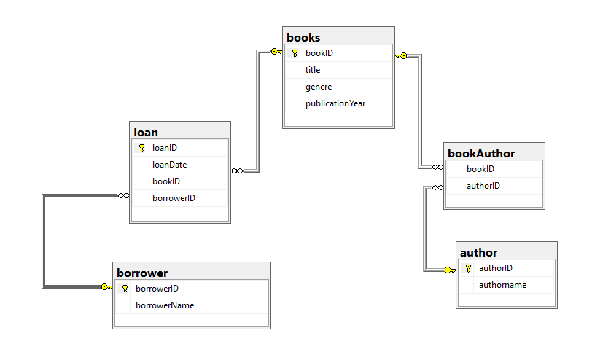
RELATIONAL SCHEMA

Slide 7
relationships
1,one-to-many(1:N)
books ↔ loan - one book can be loaned many times(but not not simultaneously)
borrower:loans -one borrower can have multiple loans
2,many-to-many(M:N)
Books ↔ Authors
A book can have multiple authors, and an author can write multiple books.
Implementation:Junction table `BookAuthor` with composite foreign keys:
3. Foreign Key Constraints
Cascading Rules:
If a book is deleted (`DELETE FROM Books`), related records in `Loan` and `BookAuthor` should be automatically removed to avoid orphaned data.
relationship type | table involved | linked by | example
1:N | books → loan | book id | ‘hamlet’ →loan records
1:N | borrower → loan | borrower id | ‘beqalu’→ their loans
M:N | books ↔ author | book author junction | ‘extreme series’ ↔ arebu abdella

Slide 8
SQL QUERY and out put
create table loan(
loanID int primary key ,
loanDate varchar(50),
bookID int ,
borrowerID int,
foreign key (bookID) references books (bookID),
foreign key (borrowerID ) references borrower(borrowerID)
);
create table bookAuthor(
bookID int ,
authorID int ,
foreign key (bookID) references books(bookID),
foreign key (authorID ) references author(authorID)
);
create database library
use library
create table books(
bookID int primary key,
title varchar(50),
genere varchar(50),
publicationYear varchar(50),
);
create table author(
authorID int primary key,
authorname varchar(45)
);
create table borrower(
borrowerID int primary key,
borrowerName varchar(50)
);

Slide 9
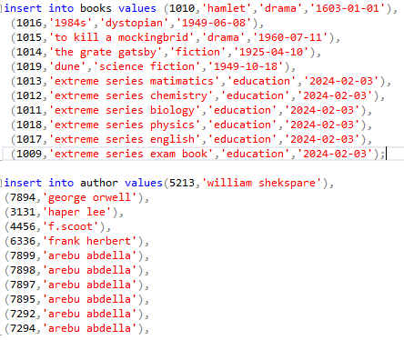
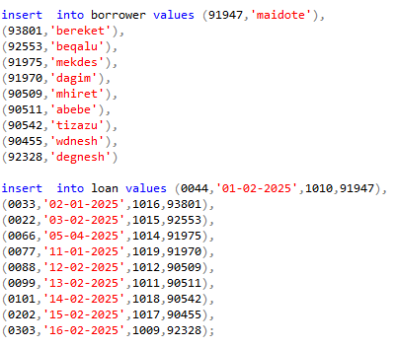
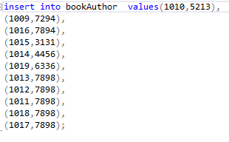
INSERT DATA INTO
BOOKS
AUTHOR
BORROWER
LOAN
BOOKAUTHOR

Slide 10
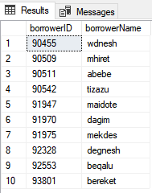
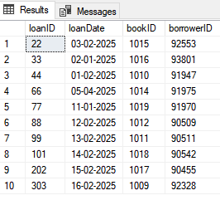
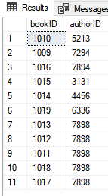
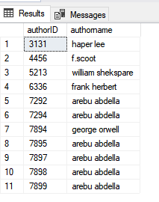
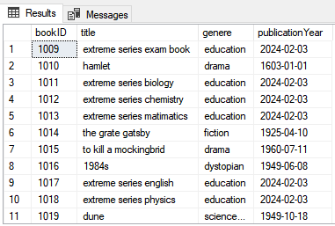
select all table
select*from books
select*from author
select*from bookauthor
select*loan
select*from borrower

Slide 11
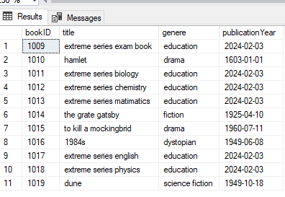
1,select*from books;

Slide 12
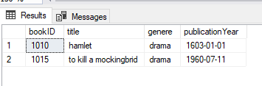
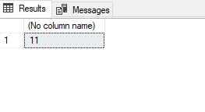
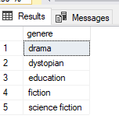
2,select*from books WHERE genere='drama';
4,select count(*)from books;
3,select distinct genere from books;

Slide 13
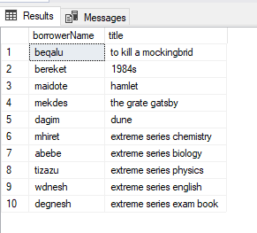
5,select B.title, A.authorname
from books B
JOIN bookAuthor BA ON B.bookID=BA.bookID
JOIN author A ON BA.authorID=A.authorID;

Slide 14
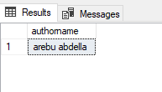
6,select A.authorname
from author A
join bookAuthor BA ON A.authorID = BA.authorID
GROUP BY A.authorname
having count (BA.bookID)>5;
7,SELECT bor.borrowerName , B.title
from borrower Bor
join loan L ON Bor.borrowerID=L.borrowerID
JOIN books B ON L.bookID=B.bookID;

Slide 15
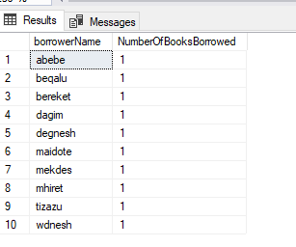
8,select bor.borrowerName ,
count (L.bookID) AS NumberOfBooksBorrowed
from borrower Bor
left join loan L ON Bor.borrowerID=L.borrowerID
GROUP BY Bor.borrowerName;

Slide 16
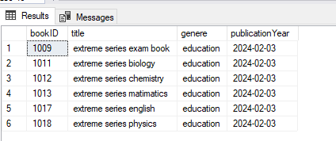
9,select * from books WHERE publicationYear ='2024-02-03';

Slide 17
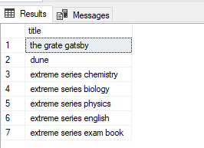
10,select B.title
from books B
join loan L ON B.bookID=L.bookID
WHERE L.loanDate>='05-04-2025';

Slide 18
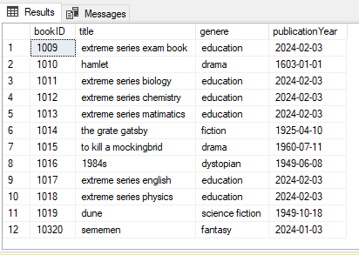
11,insert into books (bookID, title,genere, publicationYear) values (10320,'sememen','fantasy','2024-01-03' );

Slide 19
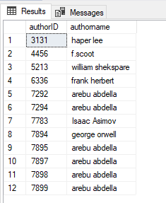
12,insert into author (authorID,authorname) values (7783,'Isaac Asimov');

Slide 20
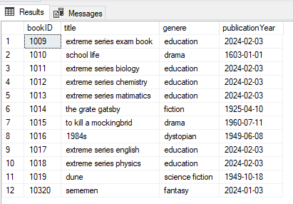
13,update books set title ='school life' where bookID=1010;

Slide 21
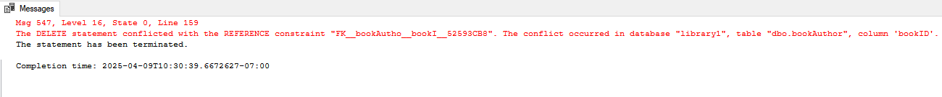
14,delete from books WHERE title='hamlet' ;

Slide 22
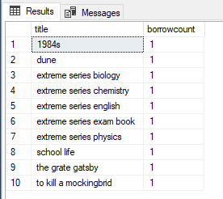
15,select B.title, count(L.bookID) AS borrowcount from books B
JOIN loan L ON B.bookID=L.bookID GROUP BY B.title
ORDER BY borrowcount DESC;

Slide 23
Deployment Strategy
Definition
Deployment is the process of installing and setting up the Library Catalog System so it can be used by users (e.g., librarians, students) to manage books, authors, loans, events, and attendees. It includes creating the database structure, inserting data, and making it functional and accessible.
Deployment Steps
A. Manual Deployment
1. Install MySQL Server and MySQL Workbench
Download and install MySQL Server from the official website.
2. Create the Database
Start by creating a new database:
CREATE DATABASE Library;
3.Use USE library; to access the DB.
4. Create Tables and Define Relationships
Write SQL CREATE TABLE statements with constraints like PRIMARY KEY, FOREIGN KEY, NOT NULL, etc.
Example:
CREATE TABLE Authors (
AuthorID INT PRIMARY KEY AUTO_INCREMENT,
AuthorName VARCHAR(100) NOT NULL
);

Slide 24
5. Insert Sample Data
Populate tables with meaningful data using INSERT INTO:
INSERT INTO Authors (AuthorName) VALUES ('xxx');
6. Run SQL Queries to Test Functionality
Execute SELECT, JOIN, and GROUP BY queries to ensure everything is working.
B. Optional: Automated Deployment (for advanced use)
Use a .sql script file with all commands.
Execute using MySQL Workbench or CLI:
mysql -u username -p < libraryCatalog.sql
Automated Deployment:
1. Write a complete SQL deployment script
2. Use Docker or container-based deployment with database setup
3. Schedule regular backups
4. Integrate with web interface (optional)

Slide 25
B. Optional: Automated Deployment (for advanced use)
Use a .sql script file with all commands.
Execute using MySQL Workbench or CLI:
mysql -u username -p < libraryCatalog.sql
Automated Deployment:
1. Write a complete SQL deployment script
2. Use Docker or container-based deployment with database setup
3. Schedule regular backups
4. Integrate with web interface (optional)

Slide 26
5. Deployment Strategy
Manual Deployment Steps:
1. Install MySQL Server.
2. Create a new database using CREATE DATABASE libraryCatalog;.
3. Use USE libraryCatalog; to access the DB.
4. Run table creation scripts.
5. Insert sample data.
6. Test queries manually.
Automated Deployment (optional):
Use a .sql script file with all commands.
Execute using MySQL Workbench or CLI:
mysql -u username -p < libraryCatalog.sql
6. Conclusion
This project successfully demonstrates a complete database system for managing a library’s catalog. It includes a well-defined schema, proper use of SQL operations, relational integrity, and meaningful data insights.

Slide 27
Conclusion
This project successfully demonstrates a complete database system for managing a library’s catalog. It includes a well-defined schema, proper use of SQL operations, relational integrity, and meaningful data insights.
Future Improvements:
Use DATE data type for better date operations.
Add Events, Attendees, and Registration tables.
Develop a web interface for user interaction.

Slide 28
THANK YOU

